Slide 1
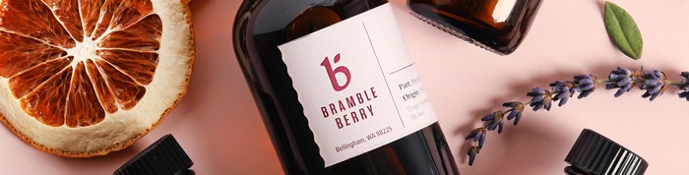
Bramble Berry
Handcraft Provisions
By Kalbert Mata, Sam Steffensen, Daniel Finley, & Astrid Bailey

Slide 2
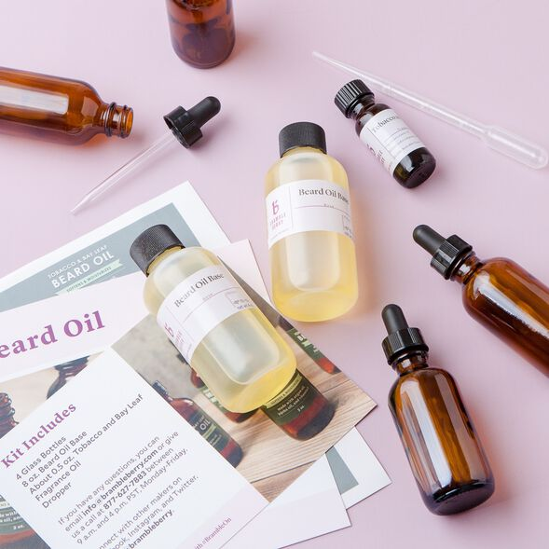
About Bramble Berry
Bramble Berry brings together creative inspiration, expert guidance and handcraft supplies to its customers.
Bramble Berry sells a myriad of products including soap base, fragrances, molds, packaging, and more.

Slide 3
History
Based in Bellingham, WA, Bramble Berry was started in 1999 by Anne-Marie Failola
Anne-Marie started the company with $15,000 worth of soap making supplies on her credit card
Today, Bramble Berry boasts over 60,000 customers and 90 employees
Founder Anne-Marie has published several books about soapmaking and has over 350k subscribers on her YouTube channel

Slide 4
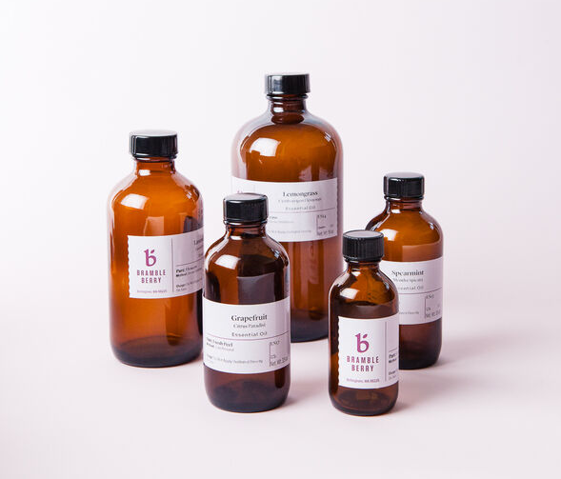
Products
Via their website, Bramble Berry customers are able to order everything necessary to create their own unique soaps, lotions, scrubs, balms, and more!
As such, Bramble Berry’s website offers two main shopping experiences:
“Shop by Product”
“Shop by Craft”

Slide 5
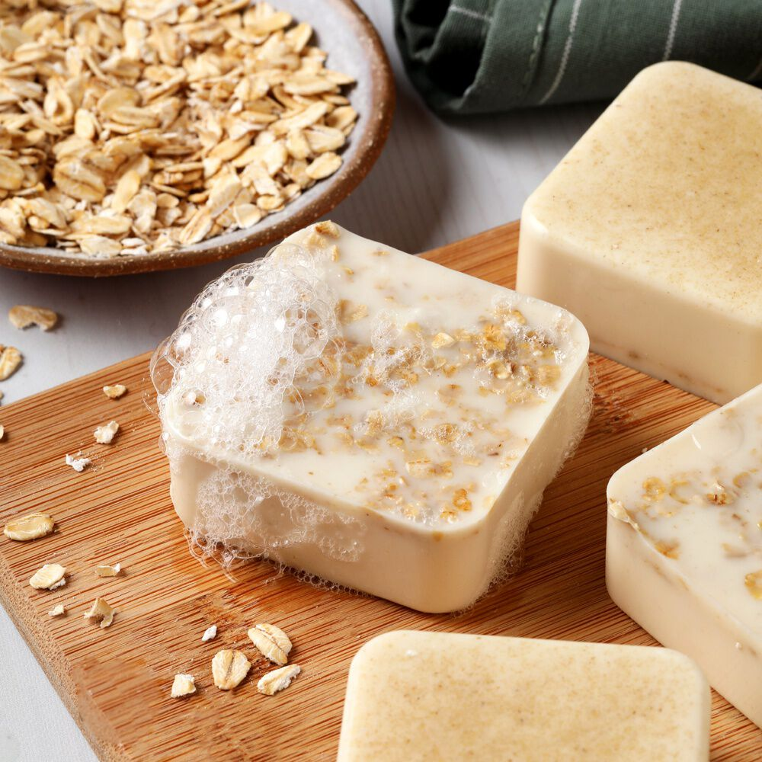
Conceptual Model

Slide 6
Conceptual Model
This project supports the following features:
Customers must be able to search for products by ingredient or by packaging.
Customers must be able write reviews.
Customer must be able to make purchases of product
Customer must be able to see their order history
Future State:
Shop by craft
In the Studio
New Products
On Sale
Summary

Slide 7
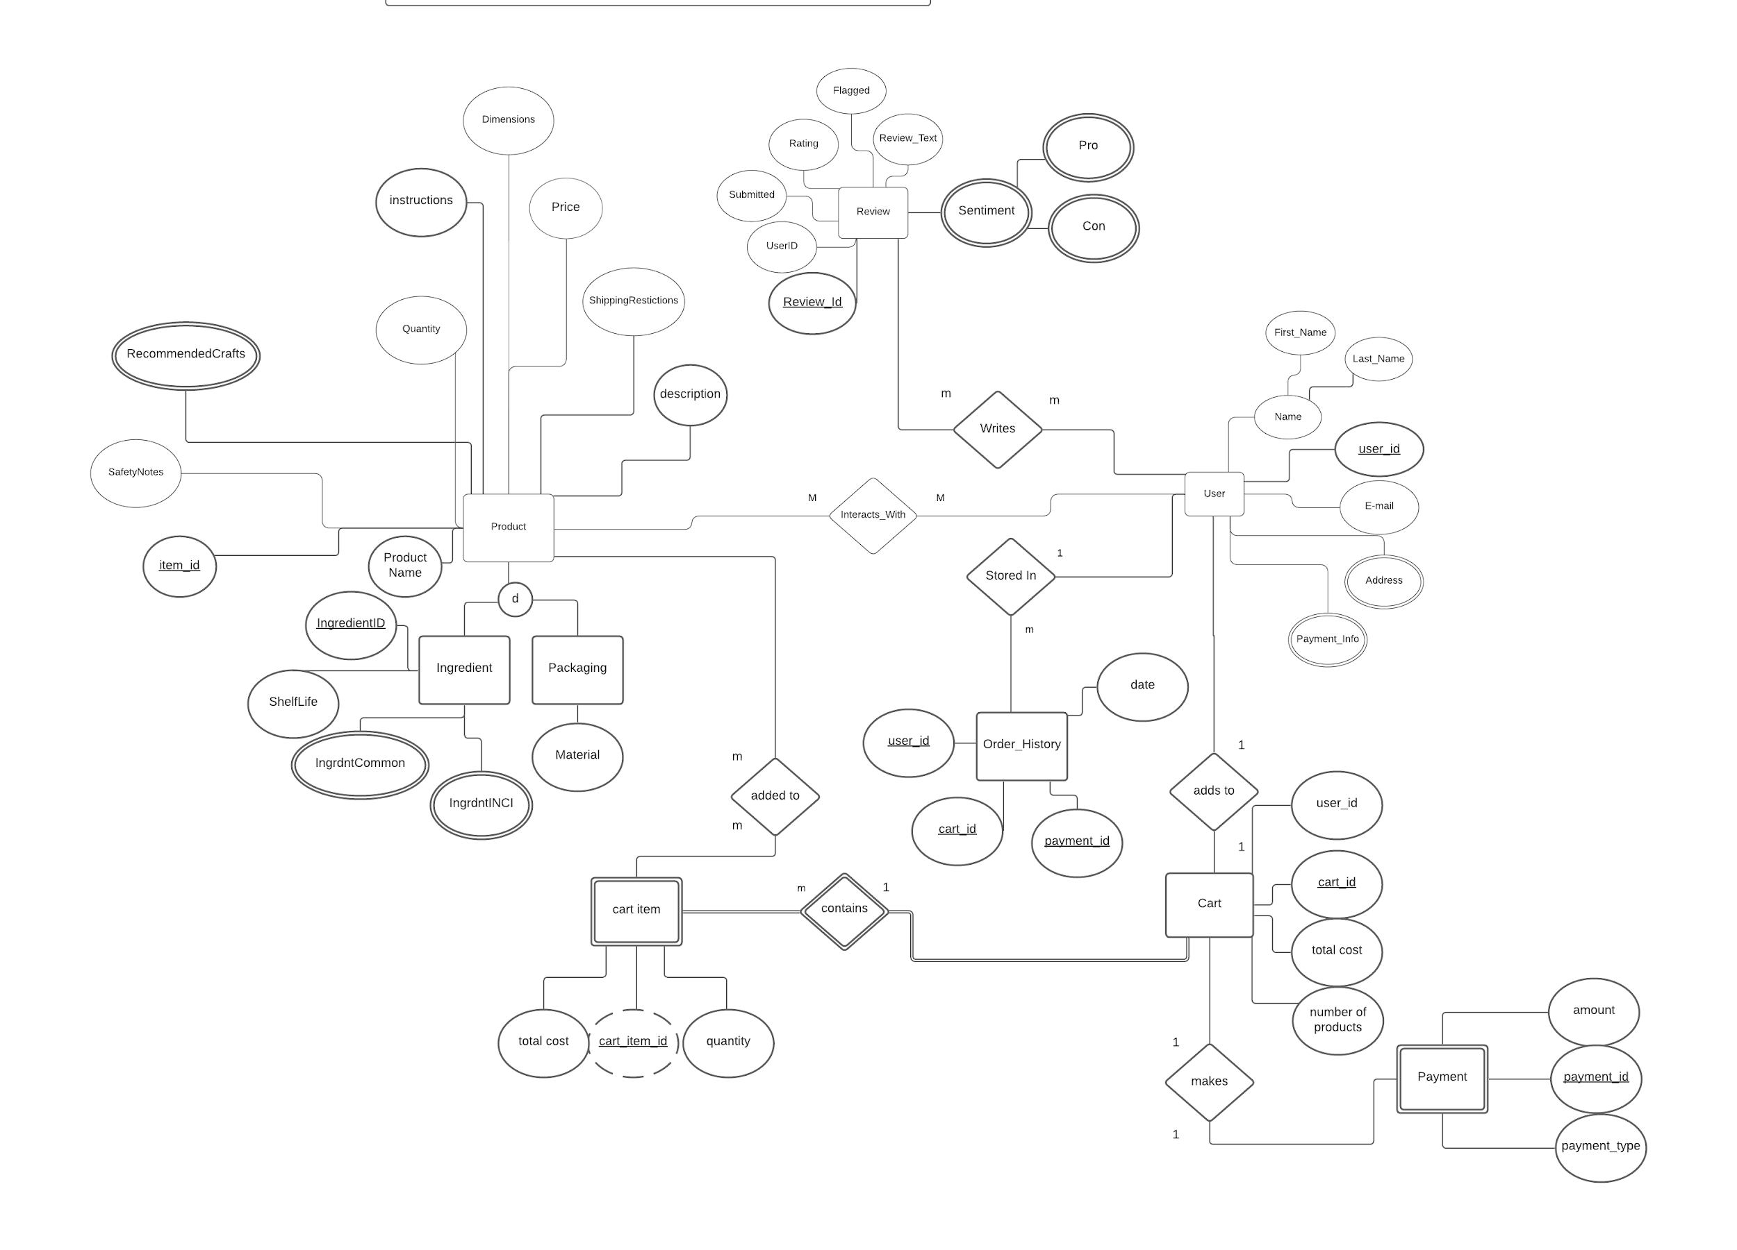
Notes:
The diagram on the previous page illustrates our conceptual model. The product tables are featured on the left, the customer on the right, the financial transaction on the bottom, and the review on the top. The customer has two main ways of interacting with the product, either by purchasing or reviewing.
The financial transaction works in a flow. A customer will choose a product that is added to their cart and that item is then assigned to the cart item table. That transaction also creates a cart for the customer that is featured in the cart table. If the customer goes through with the purchase information is added to the payment table and the order history table.
The interesting piece here, and what we focus on, is the product tables.

Slide 8
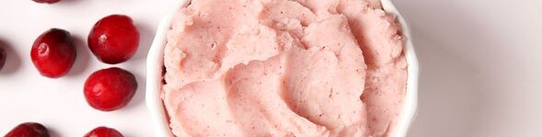
Logical Model

Slide 9
Logical Model
For our logical model, we focused on the interaction between the product tables.
At a glance, the products are organized to relate back to the craft hobby.
The rest of the model illustrates the 2 different flows
How a customer purchases the product
How the customer reviews the product.
Summary

Slide 10
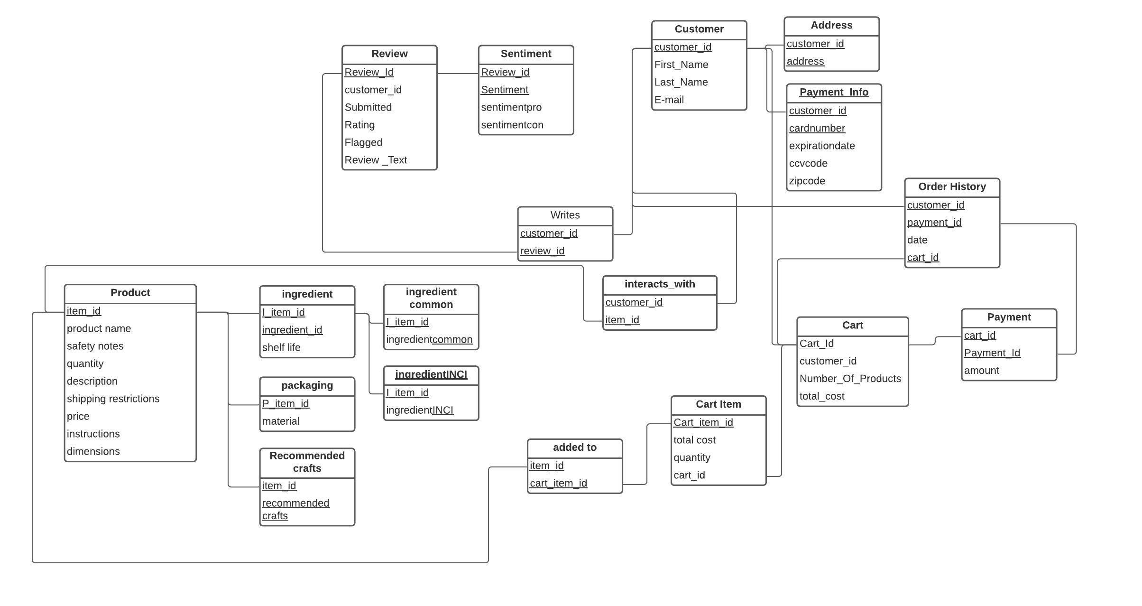

Slide 11
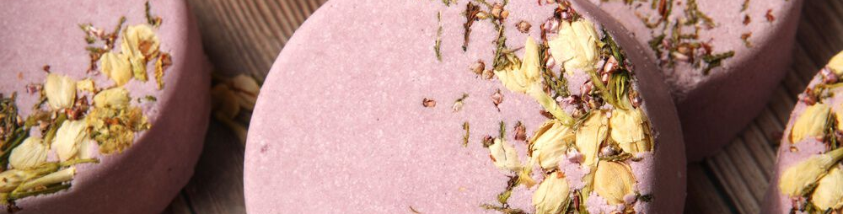
Physical Model

Slide 12
Physical Model
Tables include:
product
ingredient
packaging
craftrecommend
ingredient common
interactswith
addedto
writes
payment
cart
cart item
review
sentiment
customer
address
payment info
Orderhistory
Summary
Notes:
Tried to make it thorough and normalized

Slide 13
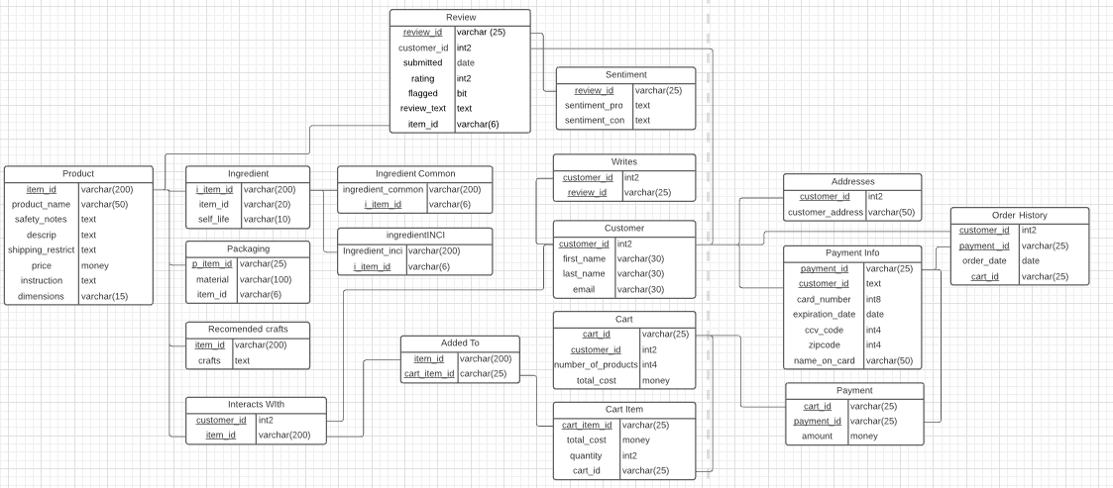
Physical Model Diagram
Notes:
Our main tables are the product, customer, review, cart, payment info, and order history tables. We also have a few subtables for each of them. The ingredient and packaging tables are there to separate the products by type into ingredient items or packaging items, as well as the specific crafts the ingredients are recommended for. The ingredient table also has two subtables indicating the ingredient’s INCI and common names for labeling purposes. We also have a subtable for customer addresses. There is a subtable for the cart items, similar to an order line item. We also have a payment table that connects the cart to the payment information for completed orders. For the review table, there is a subtable where users can choose quick pros and cons for the product in addition to their review. Finally there are some connecting tables, added to connects the cart with the products, interacts with connects the customer and products, and writes connects the review and the customer.

Slide 14
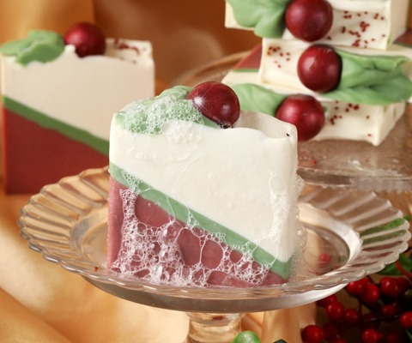
Bramble Berry is a creatively presented company that brings together the best parts of Pintrest and Etsy
It makes crafting accessible to to people of all skill levels
Takes away the warehouse feeling of ordering bulk supplies
Direct to Consumer seems to be becoming more popular and we expect to see more of these companies in the future
Bramble Berry gives crafter the power to have the experience on the website that the user wants to have by creating different and inspiring ways to view all the products
Conclusion

Slide 15
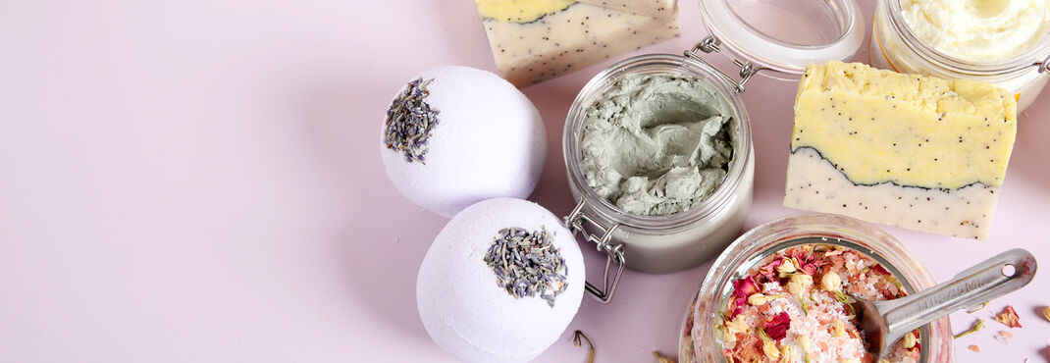
Thank You!

